Slide 1

Vending Machine Mobile PHONE ENABLED
ECEN 461 Trevor Williams AND Dan Gordon

Slide 2
Overview
Mobile Web Page Sends Request To Azure Event Hub
Raspberry Pi Reads Requests From Azure Event Hub
Raspberry Pi Triggers Solenoid Through H-Bridge
Solenoid Opens Trap Door and Drops Candy

Slide 3
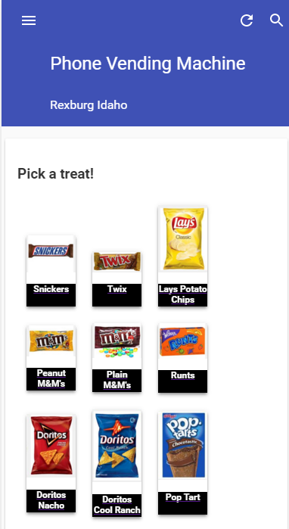
Mobile PAGE

Slide 4
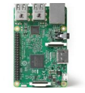
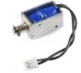
Data TransFER
WEB API
AZURE EVENT HUB

Slide 5
Machine Development Process
Developed cardboard prototypes
Developed 3D Print of Trap Door
Developed Single Trap Door on Laser Printer
Developed Inner box and Trap Door Array on Laser Cutter
Created Acrylic lid and outer shell with conventional wood shop techniques

Slide 6
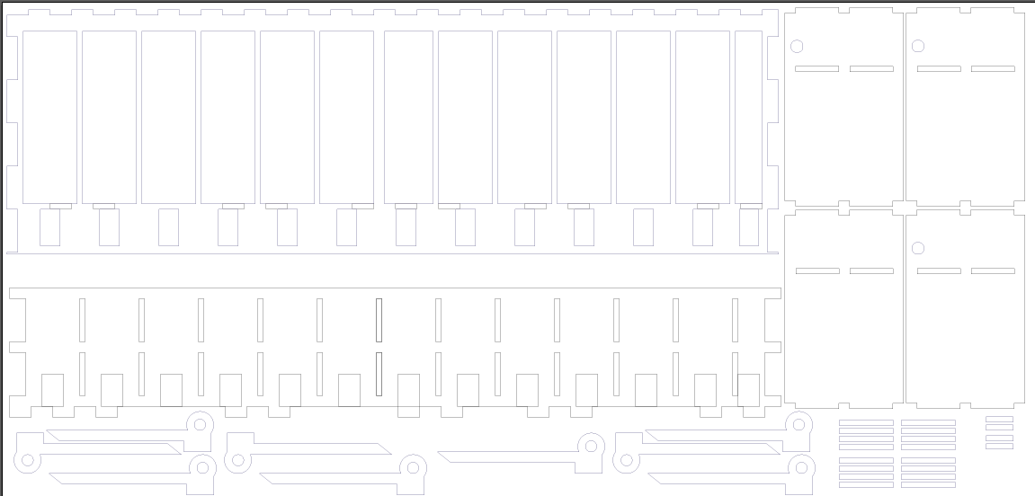

Slide 8
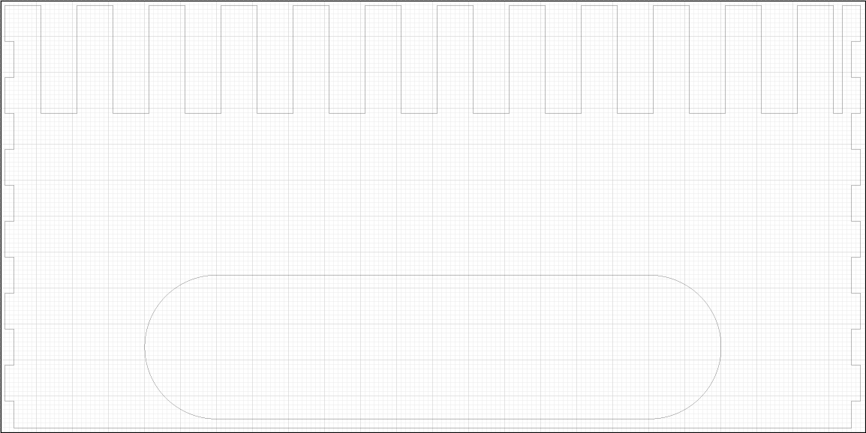

Slide 12
PHASE 1 TO DO Items
Work on trap door design for manufacturability
Add payment gateway
Add lock to lid

Slide 13
Phase 2 and Beyond TO DO ITEMS
Automate Resetting of trap doors
Create GPS enabled native mobile apps
Create tray system for rapid reload
Create GSM enabled version of machine

Slide 14
OPEN SOURCE WITH MIT LICENSE
https://github.com/gordondan/phonevend

